Slide 1
Introduction to Machine Learning (1b)
Rex W. Douglass
Institute for Political Methodology (IPM) 2018

Slide 2
Outline
 |  |  | Information Source
 |  | 0-Bits | 1-Bit | 2-Bits | N-Bits
 | 0-Bits | No Conversation | Accuracy Measures
Message | 1-Bits | No Information Conversation Selecting on the Dependent Variable | Risk Analysis/No Free Lunch Overfitting Training/Test/Cross Validation | Overdetermination
 | 2-Bits | Long No Information Conversations | Feature Selection Feature Engineering Model Complexity
 | N-Bits | Very Long No Information Conversations | Confounding Curse of Dimensionality
 |  |  | Mutual Information Accuracy, Precision, Recall,... Area Under the Curve | Cross Entropy

Slide 3
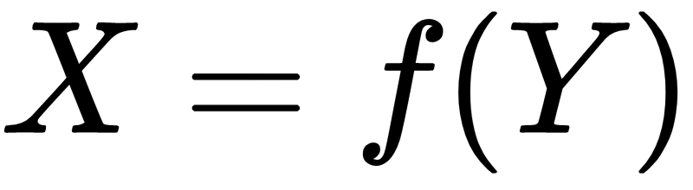
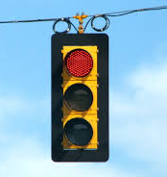
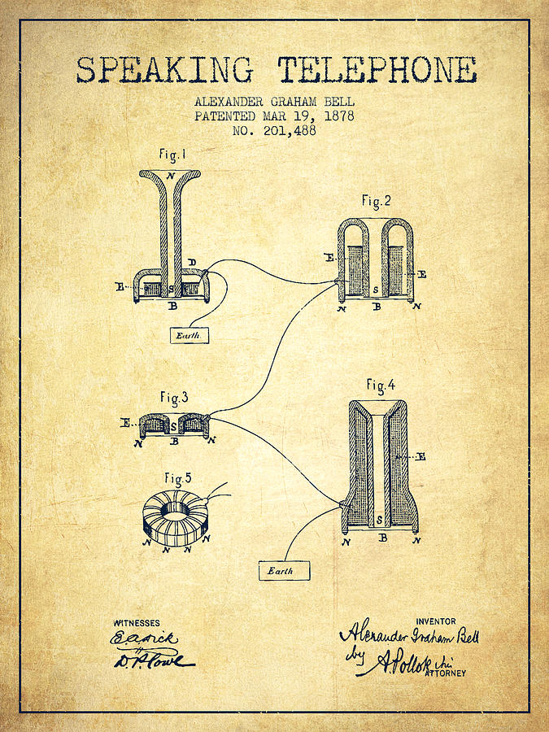
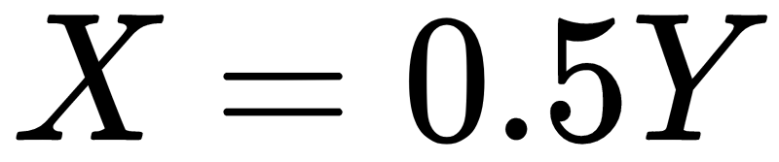
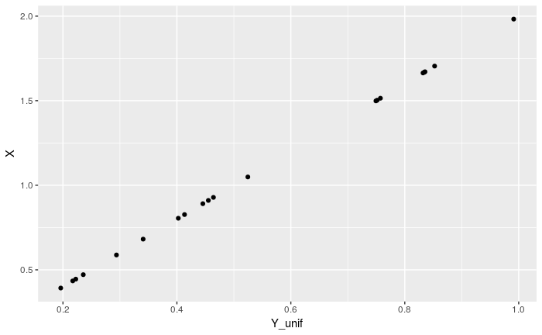
Transmitters
A Transmitter is mechanism, function, or algorithm that maps a state of the source to a message
Sometimes we get to design the transmitter
If Y=Heads then X=1, if Y=Tails then X=0

Slide 4
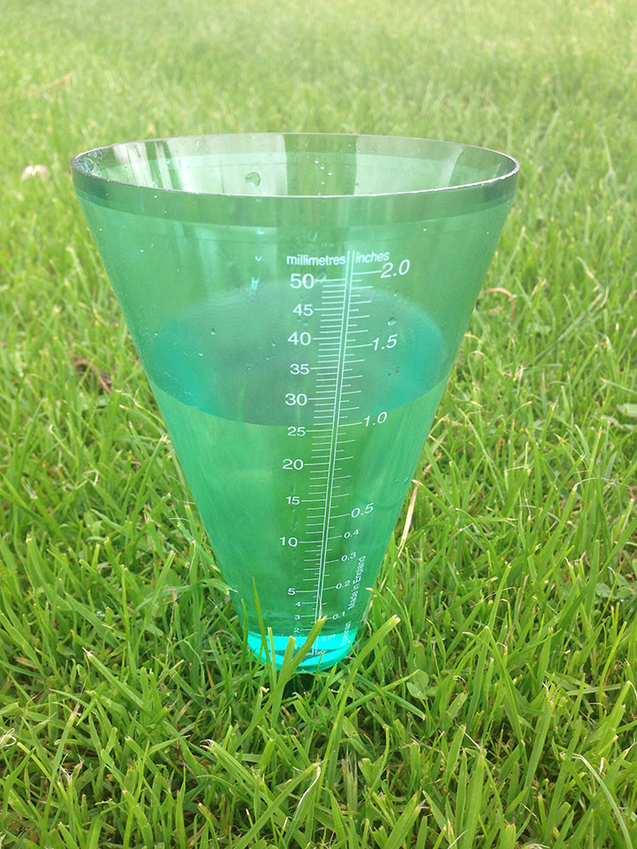
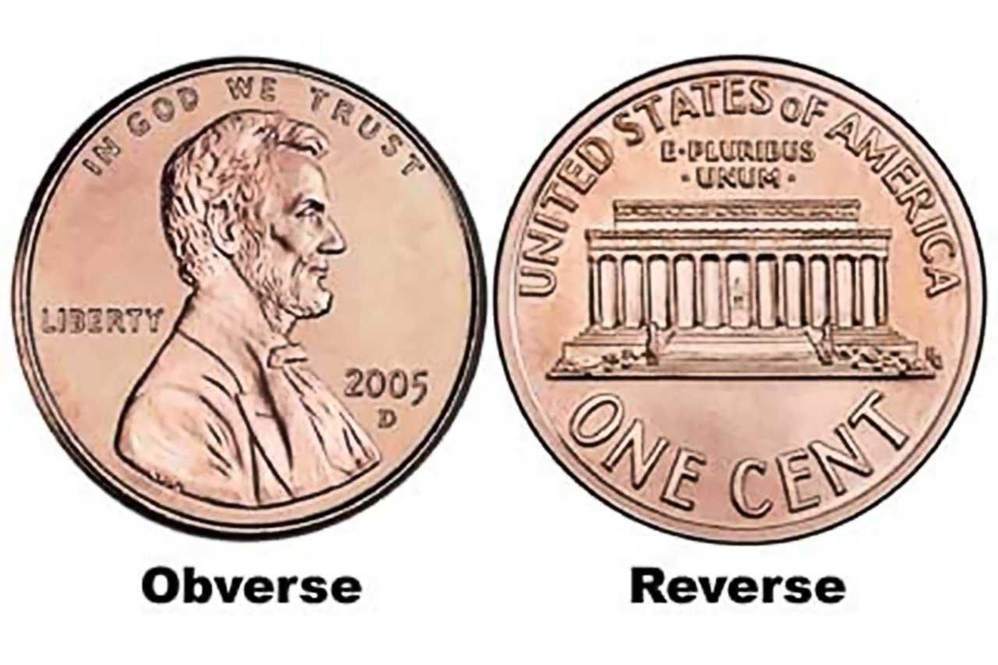
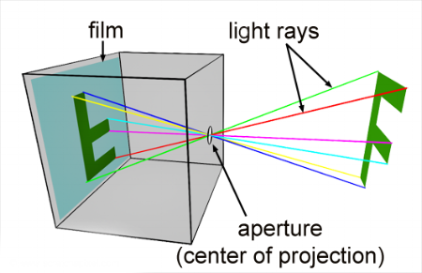
Transmitters
Most of the time, nature designs the transmitter
Flip a coin, the sides have images that are stable and point in a direction depending on how it landed
Rain gauge, some sample of rain falls into the tube
An object refracts light, which can be captured by film

Slide 5

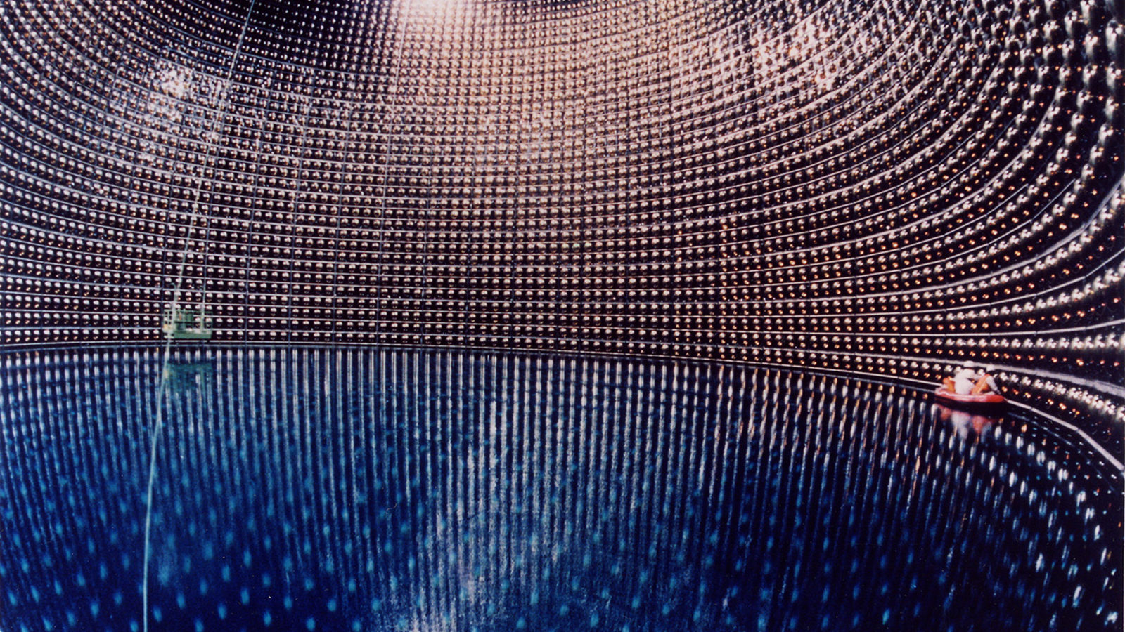
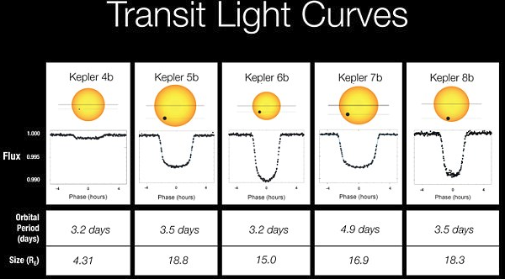
Transmitters
No guarantees about the quality of the transmitter
Might not leave a simple physical trace, e.g. the coin has the same image on both sides
Might never observe enough examples to reveal the function, e.g. one time burn pads
Might not leave a physical trace at all or one that we have access to, e.g. before the big bang
Might be intentionally obfuscated, e.g. encryption
Might be lossy, intentionally throw away information , e.g. a JPG compressed image

Slide 6
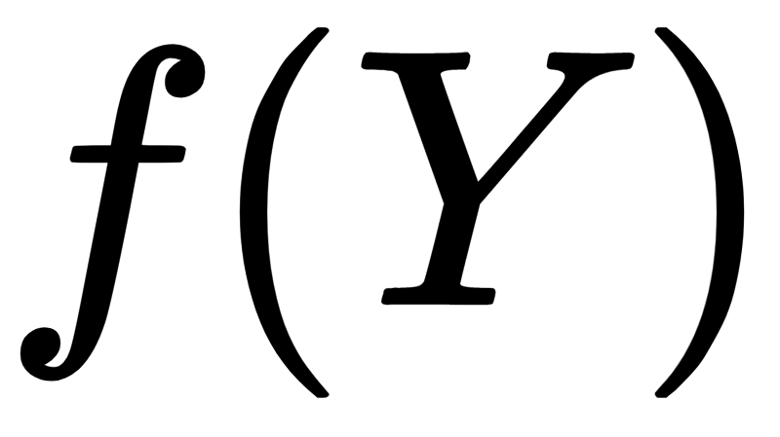
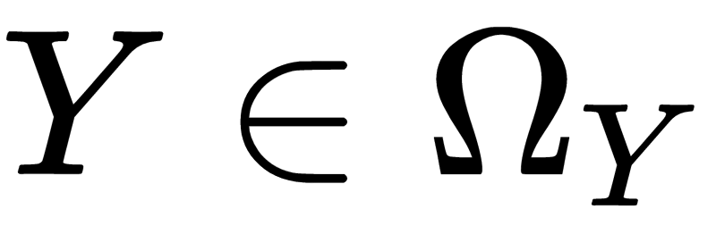
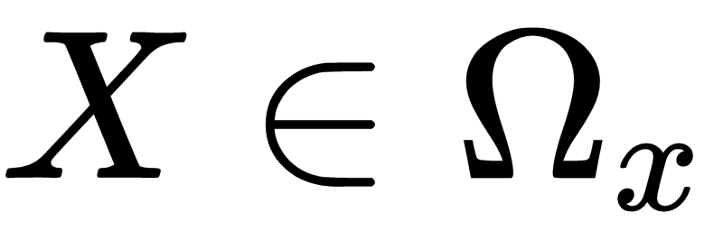
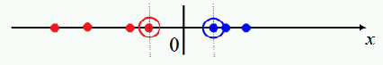
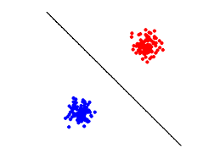
Functions
Mapping from states of the information source to messages
What’s a simple function?
Consider coin toss again {Heads, Tails}
with one message
If Heads, then X = a random number greater than or equal to zero
If Tails, then X = a random number less than zero
with two messages
If Tails, then X_1,X_2 = random numbers greater than or equal to zero
If Heads, then X_1,X_2= random numbers less than zero, X_2= a random number
X_2
X_1

Slide 7
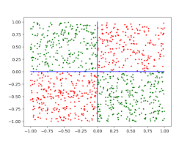
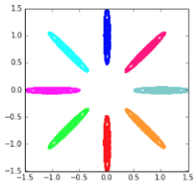
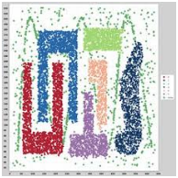
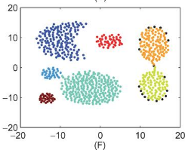
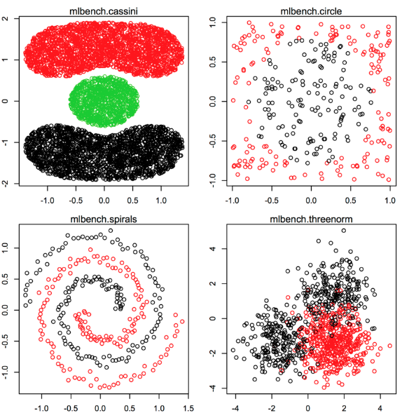
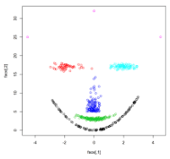
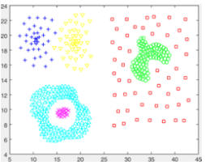
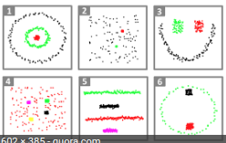
Functions
How weird can this get? (As weird as you can imagine)
Common Toy datasets, with just X and a ground truth labeled

Slide 8
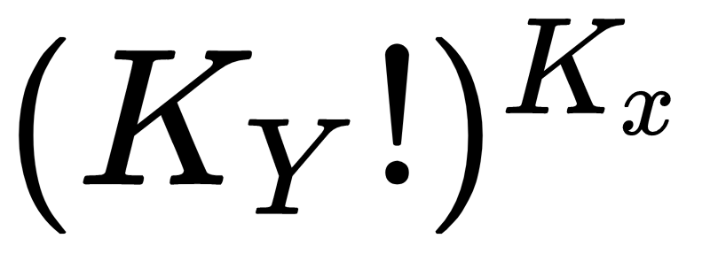
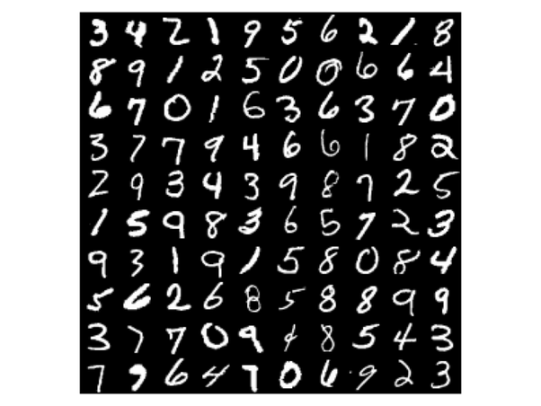
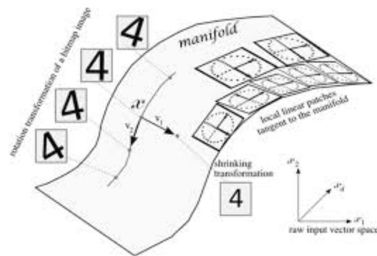
Functions
How many possible functions could there be?
A lookup table mapping each possible Y to each possible X
Enigma Machine
15^18 possible combinations
Small images
MNIST hand written digit images
10 possible digits
Small 28x28 pixel images (784 pixels)
256 brightness values for each pixel
=
There are only 10^82 atoms in the universe
We have to hope the real function is
Substantially simpler, or
There’s an approximation that captures most of the interesting info

Slide 9
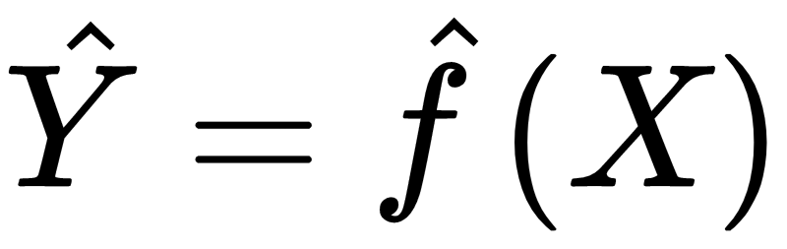
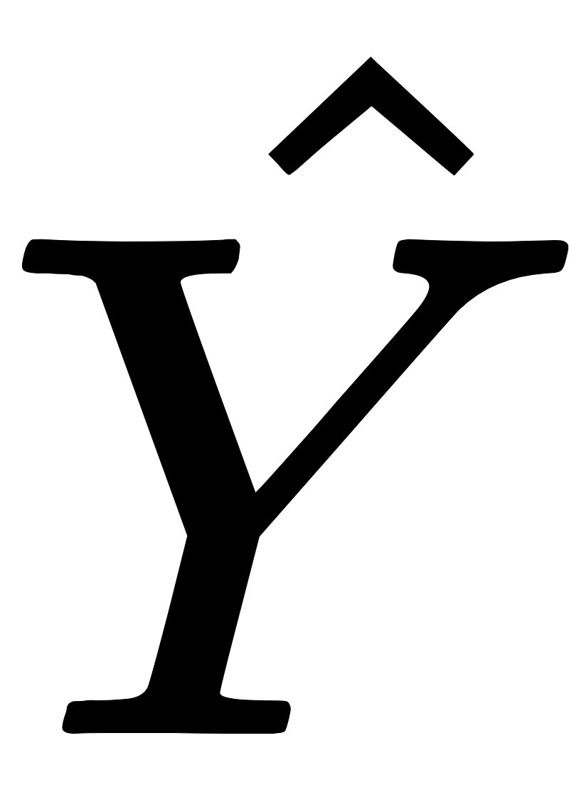
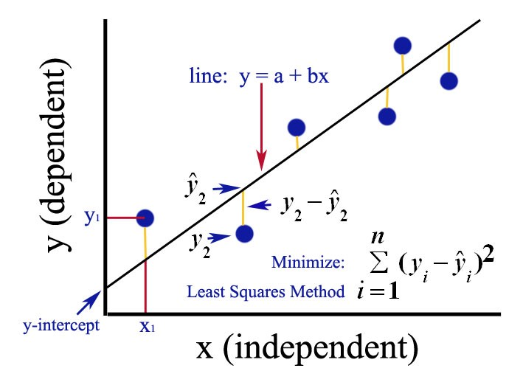
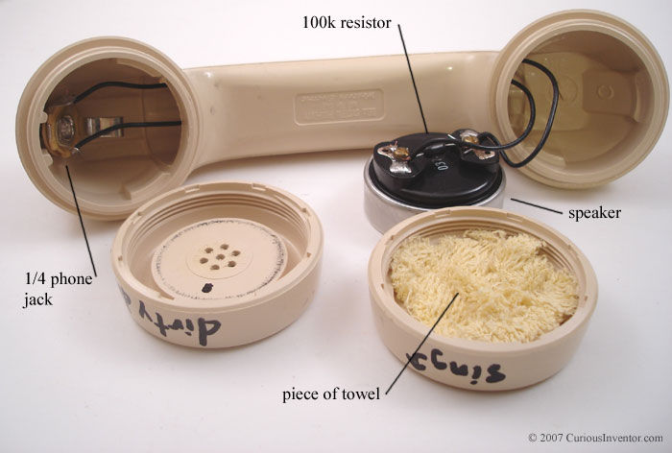
Receivers
Machine Learning is the applied science of building good receivers
A receiver is mechanism, function, or algorithm that maps messages to states of the source
Telephone speaker converts an electrical signal back into the sound of the voice of a person
Enigma Machine converted coded Nazi messages back into readable German text
Ordinary Least Squares fits a linear hyperplane to observed data

Slide 10
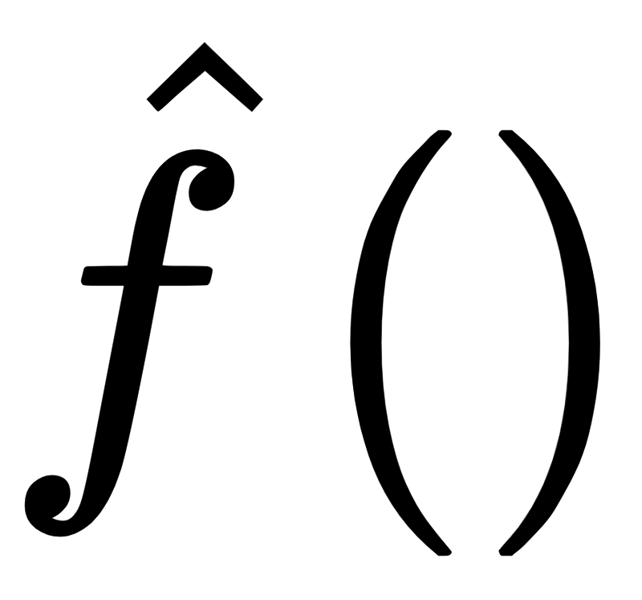
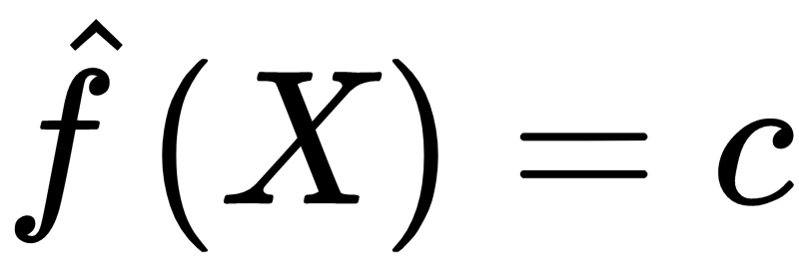
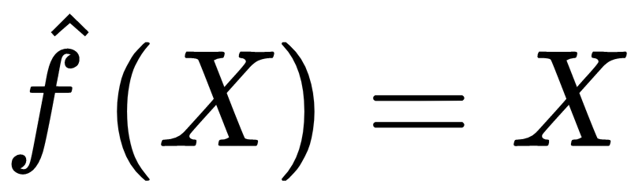
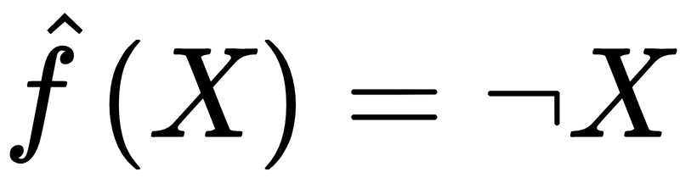
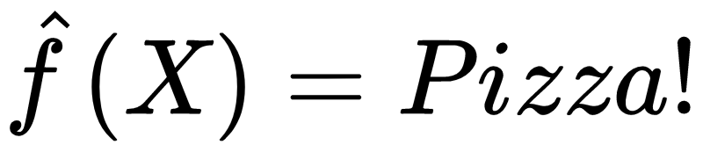
Choice of
Do you have to use a certain receiver? Nope!
Constant Function, No matter what the message says, report “Heads”
Identity Function, Report whatever the message says
Negation Function: Whatever the message, report the opposite
Pizza Function: Whatever the message says, report “Pizza!”

Slide 11
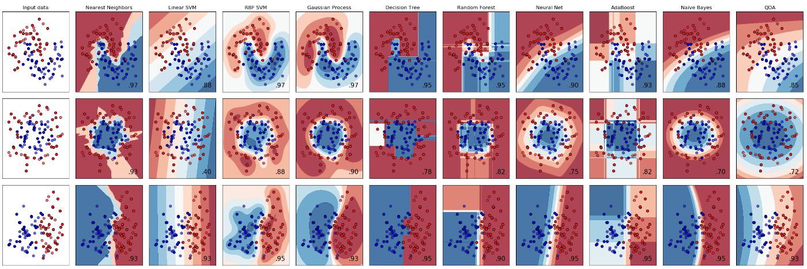
Receivers
How weird can this get? Really weird.
Linear models, decision trees, random forests, gradient boosting, support vector machines, neural networks, naive bayes, wise bayes, genetic programming, reinforcement learning, and many more*
* I made up ‘Wise Bayes’

Slide 12
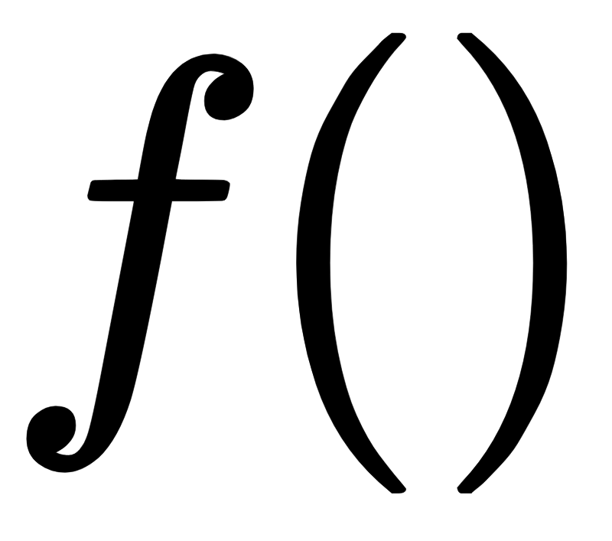
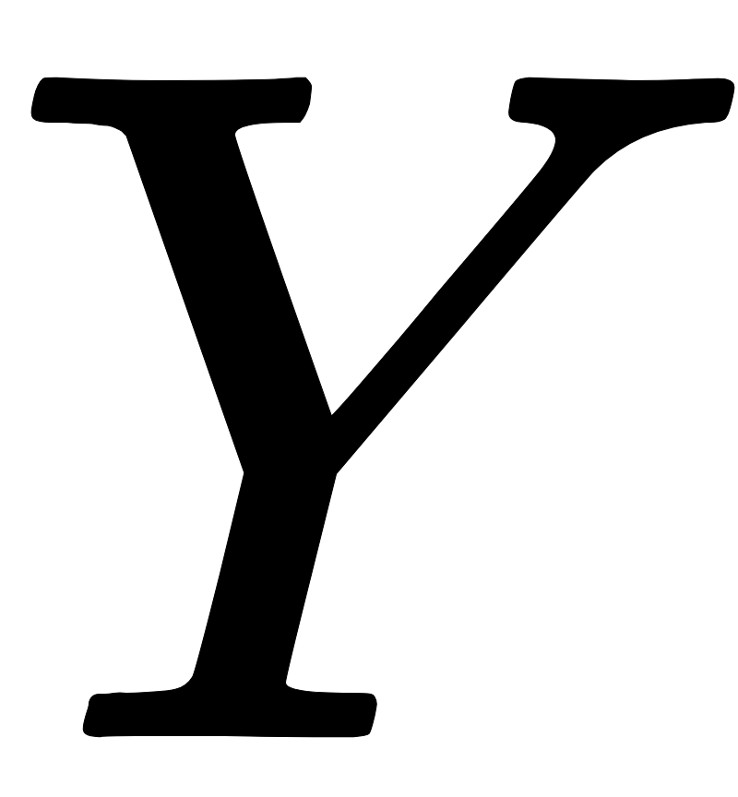
Supervised Learning, Unsupervised Learning, and Engineering
The job is always to build a
that produces accurate
What varies is how many details we get to see beforehand
Do we ever get to examine the true ground state ?
Do we ever get to examine the actual transmitter ?
 |  | Can see
 |  | Yes | No
Can see | Yes | Engineering | Supervised Learning
 | No | Engineering | Unsupervised Learning

Slide 13
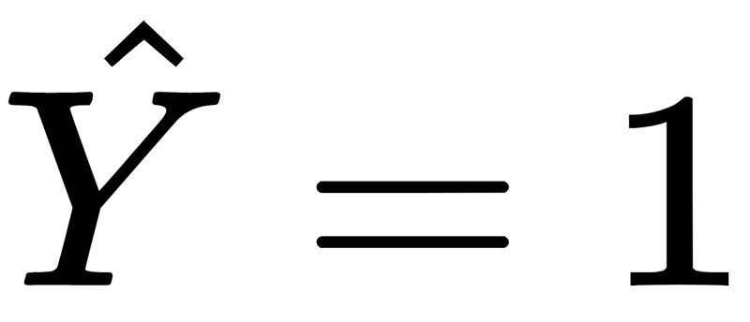
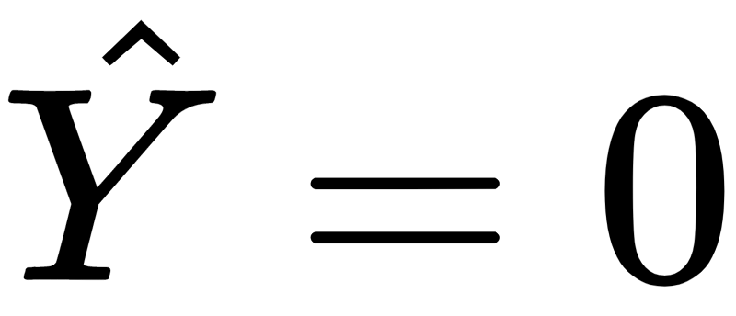
1 bit source, 1 bit message
Decision Stump
Two possible outcomes Y={0,1}
Message with two possible symbols={0,1}
Four possible (deterministic) transmission functions
Constant
f(1)=0, f(0)=0
f(1)=1, f(0)=1
Identity
f(1)=1,f(0)=0
Negation
f(1)=0,f(0)=1
Four possible (deterministic) receiver functions
Constant
f(1)=0, f(0)=0
f(1)=1, f(0)=1
Identity
f(1)=1,f(0)=0
Negation
f(1)=0,f(0)=1
Root
M=1
M=0

Slide 14
Transmitters and Receivers
= 1,0,1,0,0,0,0,1,0,0
Transmitter Function | Receiver Function
Constant 1111111111 | Constant 1111111111
 | Constant 0000000000
 | Identity 1111111111
 | Negation 0000000000
Identity 1010000100 | Constant 1111111111
 | Constant 0000000000
 | Identity 1010000100
 | Negation 0101111011
Negation 0101111011 | Constant 1111111111
 | Constant 0000000000
 | Identity 0101111011
 | Negation 1010000100

Slide 15
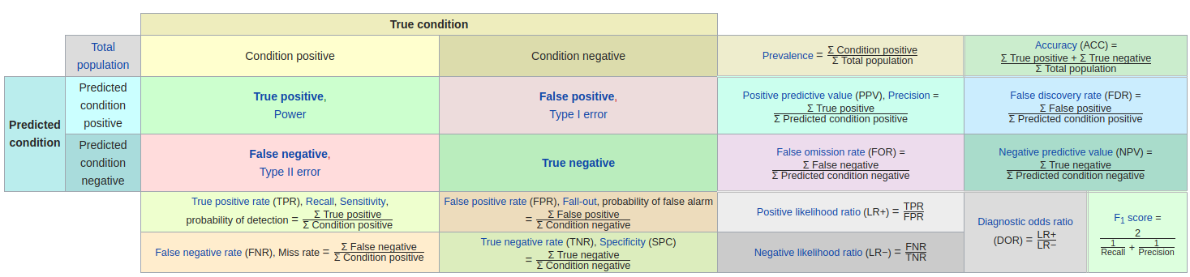
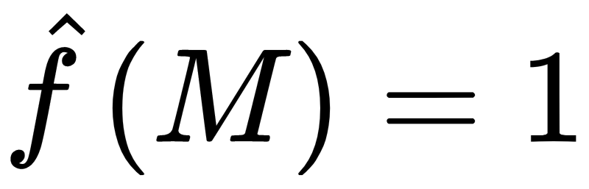
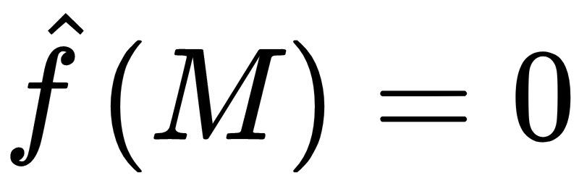
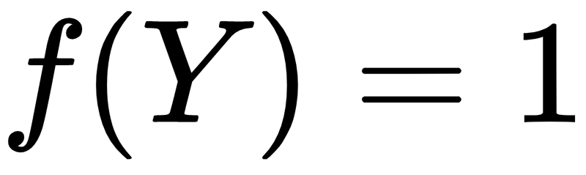
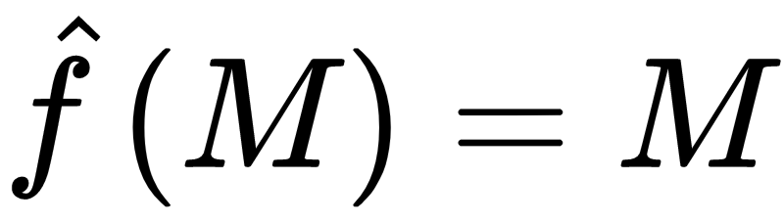
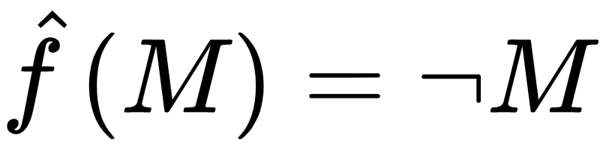
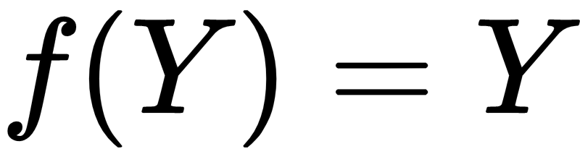
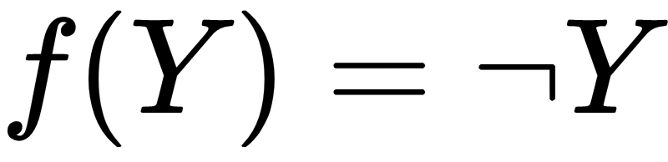
Exercise 2: Evaluate Receivers under Different Rules
= 1,0,1,0,0,0,0,1,0,0
Transmitter | Receiver | Accuracy
 |  | 0.3
 |  | 0.7
 |  | 0.3
 |  | 0.7
 |  | 0.3
 |  | 0.7
 |  | 1.0
 |  | 0.0
 |  | 0.3
 |  | 0.7
 |  | 0.0
 |  | 1.0
Takeaways
A receiver that perfectly inverts the transmitter has perfect accuracy
No single receiver is most accurate for every transmitter
Accuracy is not information!
Even when the transmitter is unrelated to the true state, a receiver can have high accuracy.
Even when the receiver is unrelated to the message, it can have high accuracy
Inaccuracy doesn’t require noise
The receiver function may just not perfectly invert the transmitter function
Perfect accuracy can be completely deterministic, even though the information source is stochastic

Slide 16
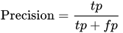
Exercise 2: Evaluate Receivers under Different Rules
= 1,0,1,0,0,0,0,1,0,0
Transmitter | Receiver | Accuracy | Precision
 |  | 0.3 | 0.3
 |  | 0.7 | Null
 |  | 0.3 | 0.3
 |  | 0.7 | Null
 |  | 0.3 | 0.3
 |  | 0.7 | Null
 |  | 1.0 | 1.0
 |  | 0.0 | 0.0
 |  | 0.3 | 0.3
 |  | 0.7 | Null
 |  | 0.0 | 0.0
 |  | 1.0 | 1.0
Takeaways
High score on one evaluation metric doesn’t imply a high score on another
0.7 accuracy but Null precision because never gets a positive right at all

Slide 17
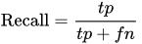
Exercise 2: Evaluate Receivers under Different Rules
= 1,0,1,0,0,0,0,1,0,0
Transmitter | Receiver | Accuracy | Precision | Recall
 |  | 0.3 | 0.3 | 1.0
 |  | 0.7 | Null | 0.0
 |  | 0.3 | 0.3 | 1.0
 |  | 0.7 | Null | 0.0
 |  | 0.3 | 0.3 | 1.0
 |  | 0.7 | Null | 0.0
 |  | 1.0 | 1.0 | 1.0
 |  | 0.0 | 0.0 | 0.0
 |  | 0.3 | 0.3 | 1.0
 |  | 0.7 | Null | 0.0
 |  | 0.0 | 0.0 | 0.0
 |  | 1.0 | 1.0 | 1.0
Takeaways
The best receiver function can change by changing the evaluation metric
0.7 Accuracy vs. 1.0 recall
A metric can assign a perfect score to a receiver that is unrelated to the message

Slide 18

Exercise 2: Evaluate Receivers under Different Rules
= 1,0,1,0,0,0,0,1,0,0
Transmitter | Receiver | Accuracy | Precision | Recall | F1
 |  | 0.3 | 0.3 | 1.0 | 0.46
 |  | 0.7 | Null | 0.0 | Null
 |  | 0.3 | 0.3 | 1.0 | 0.46
 |  | 0.7 | Null | 0.0 | Null
 |  | 0.3 | 0.3 | 1.0 | 0.46
 |  | 0.7 | Null | 0.0 | Null
 |  | 1.0 | 1.0 | 1.0 | 1.0
 |  | 0.0 | 0.0 | 0.0 | Null
 |  | 0.3 | 0.3 | 1.0 | 0.46
 |  | 0.7 | Null | 0.0 | Null
 |  | 0.0 | 0.0 | 0.0 | Null
 |  | 1.0 | 1.0 | 1.0 | 1.0
Takeaways
Need to weight different kinds of errors appropriated for your application
Reward correct hits more often than chance

Slide 19
Evaluating Receivers
Only way is to compare the reconstructed state to the true state
Need opportunities to bypass the communication channel
Don’t trust your labmate and observe the coin yourself
Listen to the person in the same room instead of over the phone
Experiment with a coin analog that you believe has the same properties

Slide 20
Observed Accuracy
= 1,0,1,0,0,0,0,1,0,0
Receiver Function | Accuracy
 | 0.3
 | 0.7
 | 0.0
 | 1.0
Simplest decision rule we can write?
Pick the receiver function with highest accuracy (smallest error)

Slide 21
In Sample Accuracy
= 1,0,1,0,0,0,0,1,0,0
= 1,0,1,0,0,0,0,1,0,0
Y(train) | Transmission Function (Negation) | Receiver Function | In Sample Accuracy
0101111000 |  |  | 0.6
 |  |  | 0.7
 |  |  | 0.0
 |  |  | 1.0
Almost every paper in the social sciences presents results on in sample data
Can tell us what function best approximates the data observed so far
Can’t tell us what function would best approximate new unseen data drawn from the same information source and transmission function

Slide 22
Out of Sample Accuracy
= 1,0,1,0,0,0,0,1,0,0
Negation 0101111011
Y(train) | Transmission Function (Negation) | Receiver Function | In Sample Accuracy
01011 |  |  | 0.6
 |  |  | 0.7
 |  |  | 0.0
 |  |  | 1.0
Can simulate acquiring new data by holding back some of the data we already have and not looking at it
Call the data we hold back test data
Call the data we use training data
Estimate the accuracy of each function on both in and out data
How does the in sample accuracy compare to the out of sample accuracy?
Y(test) | Transmission Function (Negation) | Receiver Function | Out of Sample Accuracy
00100 |  |  | 0.2
 |  |  | 0.8
 |  |  | 0.0
 |  |  | 1.0

Slide 23
Train/Test Split Takeaways
We care not how our function does on data we observed, but on how it would do on another batch of data drawn from the same source/function. Learning is fundamentally about PREDICTION
We only have the data we have
Training and Test split is an effective way to fake new data
In sample accuracy is an unbiased estimator of out of sample accuracy
Comes as a cost
Every observation you put in the test set, is one less example you get to learn from
Never touch your test data!

Slide 24
Risk and an Adversarial Partner
Given a reconstruction measure(s), how do you pick the receiver that’s likely to do best most often?
Strategic choice problem, want do well no matter what our opponent does
Demo
Coin flip but don’t agree beforehand on a message strategy (sender don’t reveal F)

Slide 25



Apriori expected mean accuracy
 |  |  | Receiver Function
 |  | 0.5 | 0.5 | 0.5 | 0.5
Transmission Function |  | 0.5 | 0.5 | 0.5 | 0.5
 |  | 0.5 | 0.5 | 1.0 | 0.0
 |  | 0.5 | 0.5 | 0.0 | 1.0
 | Mean Accuracy Across Tran Functions | 0.5 | 0.5 | 0.5 | 0.5
Before seeing any messages, there is no optimal receiver function for a given information source
All receiver functions may perform equally bad/good across possible transmission functions
Different risk types
Best case
Worse case
Average case

Slide 26

Apriori expected mean accuracy
 |  |  | Receiver Function
 |  | Constant f(1)=0, f(0)=0 | Constant f(1)=1, f(0)=1 | Identity f(1)=1,f(0)=0 | Negation f(1)=0,f(0)=1
 | Constant f(1)=0, f(0)=0 | 0.1 | 0.9 | 0.1 | 0.1
Transmission Function | Constant f(1)=1, f(0)=1 | 0.1 | 0.9 | 0.9 | 0.9
 | Identity f(1)=1,f(0)=0 | 0.1 | 0.9 | 1.0 | 0.0
 | Negation f(1)=0,f(0)=1 | 0.1 | 0.9 | 0.0 | 1.0
 | Mean Accuracy Across Tran Functions | 0.1 | 0.9 | 0.5 | 0.5
Safest on average can vary depending on the source if unbalanced
Types of Accuracies
Best Accuracy
Worst Accuracy
Average Accuracy
Improvements in one imply tradeoffs in another
Average still underperforms best

Slide 27
Evaluating Receivers (Takeaways)
The best receiver function is the one that perfectly inverts the transmitter function
That is independent of the information source
The same receiver function can perform differently on different error measures
Reconstruction error only makes sense in context - which kinds of errors do we care about and how do we weight them
Even receiver functions that ignore the message can score well on a metric
No single receiver function was best across every transmitter function
We have some theoretical guarantees about this. No free lunch!
Need to take into account the distribution of the data

Slide 28
How to pick a good receiver function?
Is there one function that is always the best?
Nope!
No Free Lunch (Wolpert and Macready 1992)
In learning problems: No learning algorithm achieves consistently better generalisation performance than any other over all possible target functions.
Corollary
No algorithm performs best across all possible evaluation metrics (e.g. accuracy, precision, recall, etc.)

Slide 29

Recap and Outline
 |  |  | Information Source
 |  | 0-Bits | 1-Bit | 2-Bits | N-Bits
 | 0-Bits | No Conversation | Accuracy Measures
Message | 1-Bits | No Information Conversation Selecting on the Dependent Variable | Receiver Functions Risk Analysis/No Free Lunch Overfitting | Overdetermination
 | 2-Bits | Long No Information Conversations | Feature Selection Feature Engineering Model Complexity
 | N-Bits | Very Long No Information Conversations | Confounding Curse of Dimensionality
 |  |  | Mutual Information Accuracy, Precision, Recall,... Area Under the Curve | Cross Entropy

Slide 30
1-bit source, 2-bit message
Y | X1 | X2
1 | 0 | 1
0 | 1 | 1
1 | 0 | 0
0 | 1 | 0
... | ...
Y | X1
1 | 3
0 | 2
1 | 0
0 | 1
... | ...
1-bit (two states) varying information source
Two sided coin
Only incidents of both war and peace
2-bit message
Two 1-bit message (each with two states)
Or, one message with 4 states
How many bits of information transmitted?

Slide 31
More complicated transmission functions (2 messages)
Flip a coin and then send two messages A and B
Two Outcomes, Y=1, Y=0
Four possible states
A=0, B=0
A=1, B=0
A=0, B=1
A=1, B=1
How many unique deterministic encoding schemes?
2^4=16
NOR
f(1)={0,0}, f(0)={1,0}
f(1)={0,0}, f(0)={0,1}
XOR
f(1)={1,0}, f(0)={0,0}
f(1)={0,1}, f(0)={0,0}
f(1)={1,0}, f(0)={1,1}
f(1)={0,1}, f(0)={1,1}
Identity A
f(1)={1,0}, f(0)={0,0}
f(1)={1,1}, f(0)={0,0}
Identity B
f(1)={0,1}, f(0)={0,0}
f(1)={1,1}, f(0)={1,0}
Nand
f(1)={0,0}, f(0)={1,1}
f(1)={1,0}, f(0)={1,1}
f(1)={0,1}, f(0)={1,1}
AND
f(1)={1,1}, f(0)={0,0}
f(1)={1,1}, f(0)={1,0}
f(1)={1,1}, f(0)={0,1}
XNOR
f(1)={0,0}, f(0)={1,0}
f(1)={0,0}, f(0)={0,1}
f(1)={1,1}, f(0)={1,0}
f(1)={1,1}, f(0)={0,1}
Negation A
f(1)={0,0}, f(0)={1,0}
f(1)={0,1}, f(0)={1,0}
Negation B
f(1)={0,0}, f(0)={0,1}
f(1)={1,0}, f(0)={1,1}
Constant
f(1 or 0)={1,1}
f(1 or 0)={0,0}
f(1 or 0)={0,1}
f(1 or 0)={1,0}
OR
f(1)={1,1}, f(0)={0,0}
f(1)={1,0}, f(0)={0,0}
f(1)={0,1}, f(0)={0,0}

Slide 32
Feature Selection
Sometimes one or more messages are completely unrelated to the source
No way to tell a-priori if this is the case
No way to know after either
dead feature could turn on on some unknown condition
Applying zero weight to a feature is mathematically equivalent to leaving it out of the model
A is hot, B is dead
B is hot, A is dead
Identity A
f(1)={1,0}, f(0)={0,0}
f(1)={1,1}, f(0)={0,0}
Negation A
f(1)={0,0}, f(0)={1,0}
f(1)={0,1}, f(0)={1,0}
Negation B
f(1)={0,0}, f(0)={0,1}
f(1)={1,0}, f(0)={1,1}
Identity B
f(1)={0,1}, f(0)={0,0}
f(1)={1,1}, f(0)={1,0}

Slide 33

Feature Selection False Discovery Rates (1/)

Slide 34

Feature Selection Unintentional False Discovery Rates (2/)
“Do We Really Know the WTO Cures Cancer?” (Chaudoin et al. 2014)
Population of studies published in APSR, AJPS, and IO from 2005-2013
34 dependent variables unrelated to trade
WTO membership has a statistically significant relationship with 34% of unrelated outcomes in international relations
Much higher than P-value would suggest
Adding covariates, fixed effects, and matching doesn’t solve the problem

Slide 35

Feature Selection Intentional False Discovery Rates (3/)
(Lenz and Sahn 2017)
AJPS Replication Archive
Add covariates until key independent variable becomes ‘significant’
Added ‘control variables’ tend to increase the effect size, not the precision of its estimate
Can’t prove intent, but:
Authors almost never justified those control variables
They were much less likely to report bivariate comparisons if their effect size needed them

Slide 36

Feature Engineering
Simpson’s Paradox
Excluding a necessary message can give
The wrong prediction
The wrong interpretation of the role of a message in the transmission function

Slide 37




Feature Engineering
AND
f(1)={1,1}, f(0)={0,0}
f(1)={1,1}, f(0)={1,0}
f(1)={1,1}, f(0)={0,1}
Functions that depend on the state of two messages simultaneously
Logic gates
And
Or
Nor
Interaction Terms
OR
f(1)={1,1}, f(0)={0,0}
f(1)={1,0}, f(0)={0,0}
f(1)={0,1}, f(0)={0,0}
Nand
f(1)={0,0}, f(0)={1,1}
f(1)={1,0}, f(0)={1,1}
f(1)={0,1}, f(0)={1,1}
NOR
f(1)={0,0}, f(0)={1,0}
f(1)={0,0}, f(0)={0,1}

Slide 38
Model Complexity and Regularization
We can end up fitting functions that ever ‘unnecessary’ parts
And gate inverts any one of these three transmitter functions
But it has 4 rules instead of the real 2
Bad for 3 reasons
Parsimony - More theory than is actually in the real world
Budget- requires more computational power and measurement than may actually be needed
May not generalize to new data - especially if unneeded parts are fit to noisy parts of the message
AND
f(1)={1,1}, f(0)={0,0}
f(1)={1,1}, f(0)={1,0}
f(1)={1,1}, f(0)={0,1}

Slide 39
2 messages Takeaways
2 messages with a 2 symbol alphabet is equivalent to one one message with a 4 symbol alphabet
Number of possible transmission functions grows quickly in the message space
From 4 deterministic functions to 22 by adding 1 bit
Unnecessary message length, using 2 bits to represent 1 bit of information
Parts of messages can be superfluous (wasted bandwidth, feature selection)
There are receiver functions that perfectly recover the message but are more complicated than necessary, e.g.
Transmission function f(1)={1,1}, f(0)={1,0}
Receiver Function AND gate f(1,1)=1; f(1,0)=0; f(0,1)=0; f(0,0)=0

Slide 40
2-bit information source, 1-bit messages
Y | X1
1 | 0
2 | 1
3 | 0
4 | 1
... | ...
Issue of Bandwidth
There are more states of the information source than can be conveyed by message the
Underdetermined
More outcomes than there are unique messages to indicate

Slide 41
1-bit information source, N-bit messages
Y | X1 | X2 | X3 | ...
1 | 0 | 1 | 1 | ...
0 | 1 | 1 | 1 | ...
1 | 0 | 0 | 0 | ...
0 | 1 | 0 | 1 | ...
... | ... | ... | ...
Sometimes we have many more messages than outcomes
Feature selection problem in the extreme
As K -> infinity, any one feature likely to correlate with the outcome
Functions of features definitely likely to correlate with the outcome
Curse of Dimensionality
Distance between observations goes to 1
Every observation become a unique and special snowflake (no obvious patterns)

Slide 42


Curse of Dimensionality Visualized
The amount of space occupied by 20% of the training data in 1,2, and 3 dimensions
Our confidence in a decision boundary lies in how many training data examples lie in that region, hopefully on either side of a line
As dimensions increase, the number of example near any one point, or any one line decrease
The amount of training data required to maintain the same coverage in an area increases exponentially in the dimension of that area
The number of examples near the origin, decreases exponentially

Slide 43
Conclusion: Fundamental Problems of Learning
Successful machine learning strategies offer solutions to
Bias/Variance Trade Offs and Worst/Average/Best Case Analysis
Feature Selection
Feature Engineering
Overfitting
Curse of Dimensionality

Slide 44
Next Time: Technological Approaches to these Problems
 | Linear Models | Decision Trees | Random Forests | Neural Networks
Bias/Variance Trade Off
Feature Selection / Curse of Dimensionality | L1/L2 Penalties | Greedy splitting | Split criteria, Subsampling Variables | L1/L2 Penalties / Hierarchical Structure
Feature Engineering | Interaction Terms, Splines | Sequential Splitting | Decision Trees | Dense Layers
Overfitting | Cross-Validation | Pruning | Subsampling Observations | Early Stopping

